Slide 1
Mobile Development :
3 : Android Native Development : Part 1 Getting Started
Professor Imed Bouchrika National School of Artificial Intelligence imed.bouchrika@ensia.edu.dz

Slide 2
Outline :
Section 1 :
Introduction to Android
Getting Started : Hello World
Simple App, Project Structure, Manifest, Events…
Android App Components:
Activities, Widgets, Layouts
Section 2 :
Example : Tic Tac toe Game
Section 3 :
Kotlin : OOP

Slide 3
Recap for Week 2: Idea, Process & App Design
Software Process Activities for Mobile App Solutions
Techniques and ways for discovering new ideas
Idea Validation & Feasibility Analysis
Usability, User Experience and Design
Technological & Development Aspects
Business Models

Slide 4
Section 1
Android Development

Slide 5
Introduction to Android
Android is :
Mobile operating system based on Linux kernel
Can be considered as a software stack that includes an operating system, middleware, and key applications for mobile and embedded devices
It includes user Interfaces for touch screens
Highly customizable for devices / by vendors

Slide 6
Introduction to Android
Why develop for Android OS:
Used on over 80% of all smartphones
Simple, powerful, and open SDK, no licensing fees, excellent documentation.
Powers devices such as watches, TVs, and cars
Billions of users having Android Mobile Phones
Android runs on different platforms created by numerous manufacturers including : Samsung, LG ( Exiting the market ), Xiaomi, Motorola, Nokia…

Slide 7
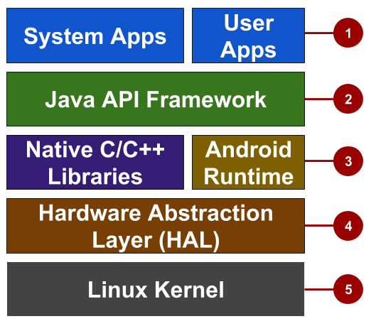
Introduction to Android
Android Operating System Stack
System and user apps
Android OS API in Java framework
Expose native APIs; run apps
Expose device hardware capabilities
Linux Kernel

Slide 8
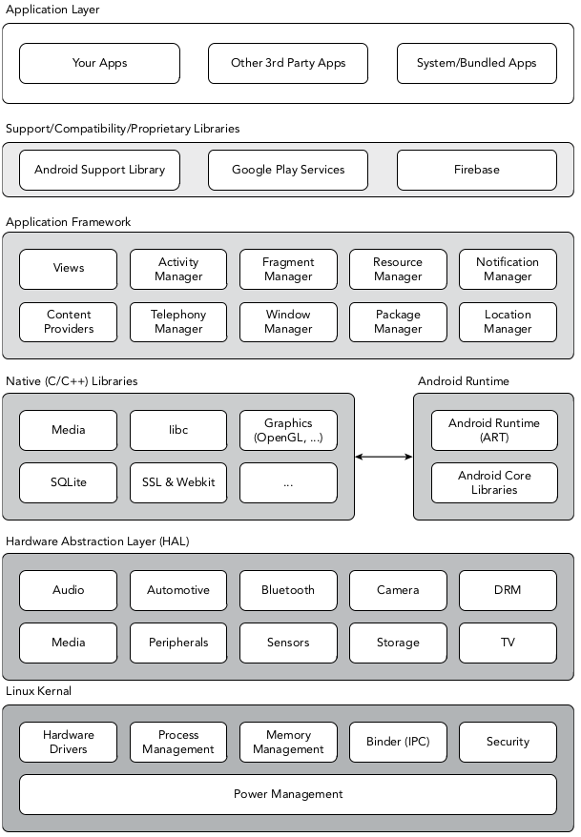
Introduction to Android
Android Operating System Stack

Slide 9
Introduction to Android
Android Operating System Stack
User Apps + System Apps : Apps created by developers along with core system apps for email, SMS messaging, calendars, internet browsing, and contacts.
Java API framework : All features for Android development, such as UI components, resource management, and lifecycle management, are available through application programming interfaces (APIs).

Slide 10
Introduction to Android
Android Operating System Stack
Native C/C++ Libraries : They include various C/C++ core libraries such as libc and SSL, as well as the following:
A media library for playback of audio and video media
A surface manager to provide display management
Graphics libraries that include OpenGL for 2D and 3D graphics
SQLite for native database support
SSL and WebKit for integrated web browser and Internet security
These native libraries are available to apps through the Java API framework.

Slide 11
Introduction to Android
Android Operating System Stack
Android Runtime (ART) :
It functions the same way as a traditional Java Virtual Machine BUT
Android uses its own custom run time designed to ensure that multiple instances run efficiently on a single device.
app runs in its own process, with its own instance of the Android runtime.

Slide 12
Introduction to Android
Android Operating System Stack
Hardware Abstraction Layer (HAL) :
This layer provides standard interfaces that expose device hardware capabilities to the next layer so it can be utilised by the higher-level Application framework.
The HAL consists of multiple library modules, each of which implements an interface for a specific type of hardware component, such as the camera or Bluetooth module.

Slide 13
Introduction to Android
Android Operating System Stack
Hardware Abstraction Layer (HAL) :
This layer provides standard interfaces that expose device hardware capabilities to the next layer so it can be utilised by the higher-level Application framework.
The HAL consists of multiple library modules, each of which implements an interface for a specific type of hardware component, such as the camera or Bluetooth module.

Slide 14
Introduction to Android
Android Operating System Stack
Linux Kernel :
The layers above the Linux kernel rely on the Linux kernel for threading, low-level memory management, power consumption, resources, network, hardware drivers and other underlying core functionality.

Slide 15
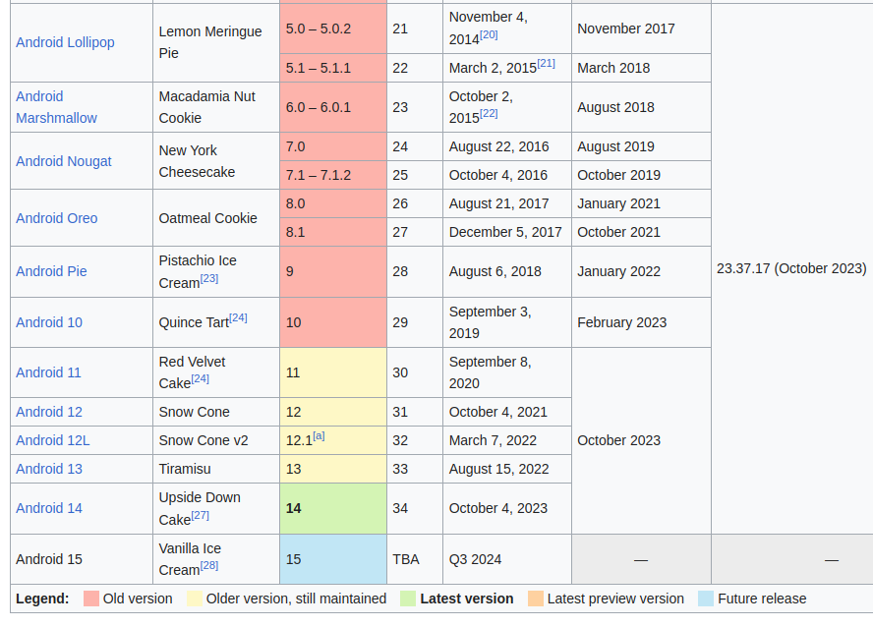
Introduction to Android
Versions :
https://en.wikipedia.org/wiki/Android_version_history

Slide 16
Introduction to Android
Software Development Kit (SDK) for Android
It includes everything you need to start developing, testing, and debugging Android applications:
The Android API Libraries : provide developer access to the Android stack. These are the same libraries that Google uses to create native Android applications.
Development tools: including the Android Studio IDE and several other development tools that let you compile and debug your applications to turn Android source code into executable applications.
The Android Virtual Device Manager and Emulator—The Android Emulator is a fully interactive mobile device emulator featuring several alternative skins. The Emulator runs within an Android Virtual Device (AVD) that simulates a device hardware configuration. Using the Emulator you can see how your applications will look and behave on a real Android device.
Full documentation
Sample code : SDK includes a selection of sample applications that demonstrate some of the possibilities available with Android, as well as simple programs that highlight how to use individual API features.

Slide 17
Introduction to Android
Software Development Kit (SDK) for Android
It includes everything you need to start developing, testing, and debugging Android applications:
The Android Virtual Device Manager and Emulator : The Android Emulator ( As a virtual device) runs within an Android Virtual Device (AVD) that simulates a device hardware configuration. Using the Emulator you can see how your applications will look and behave on a real Android device.
Sample code : SDK includes a selection of sample applications….
Full documentation

Slide 18
Introduction to Android
Android Operating System Stack
Native Development Kit :
If the speed and efficiency of C/C++ is required for your application, Android provides a native development kit (NDK).
The NDK is designed to enable you to create C++ libraries using the libc and libm libraries, along with native access to OpenGL.

Slide 19
Getting Started : Hello World App
Provided that :
You did :
Market research
Idea Validation
Planning, UI/UX Design
Software Architecture
Downloaded and Installed successfully:
Android Studio
Android SDK and Tools

Slide 20
Getting Started : Hello World App
Provided that :
You did :
Market research
Idea Validation
Planning, UI/UX Design
Software Architecture
Downloaded and Installed successfully:
Android Studio
Android SDK and Tools
Recommended to have an Android Phone + USB Cable to connect your Phone to your Dev PC

Slide 21
Getting Started : Hello World App
Before your start the development, Remember that compared to desktop or notebook computers, mobile devices have relatively:
Low processing power
Limited RAM
Limited storage capacity
Small screens
High costs associated with data transfers
Intermittent connectivity, slow data transfer rates, and high latency
Limited battery life

Slide 22
Getting Started : Hello World App
App Idea : Mobile App for a user to press a button for incrementing a counter.
Primary Users : bored people with nothing to do or people with insomnia
You clicked :
78
times
Click me

Slide 23
Getting Started : Hello World App
Create a Project
Under Android Studio :
File ⇒ New ⇒ New Project
In the next Wizard select : Empty Views Activity otherwise ,Empty Activity
1

Slide 24
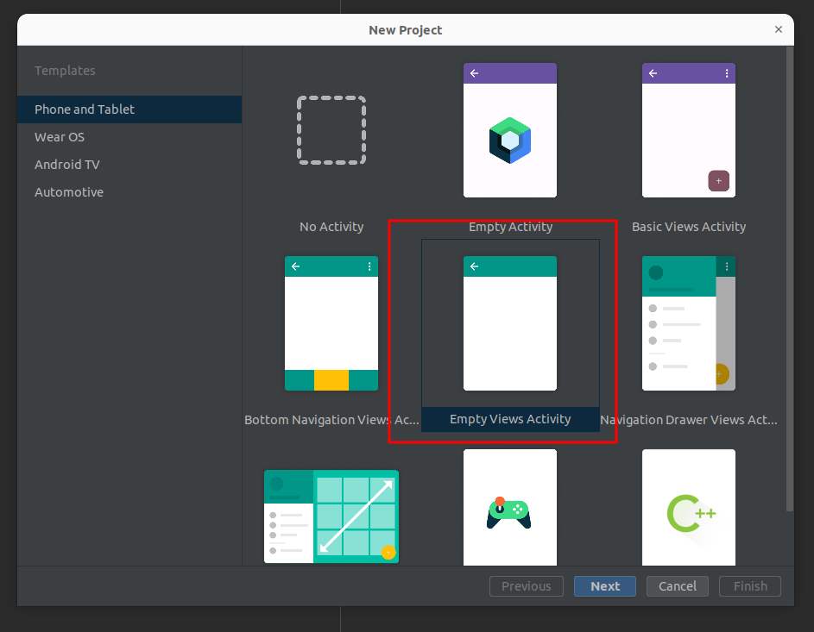
Getting Started : Hello World App
Create a Project
Under Android Studio :
File ⇒ New ⇒ New Project
In the next Wizard select : Empty Views Activity otherwise ,Empty Activity
1
We will NOT be using Jetpack Compose

Slide 25
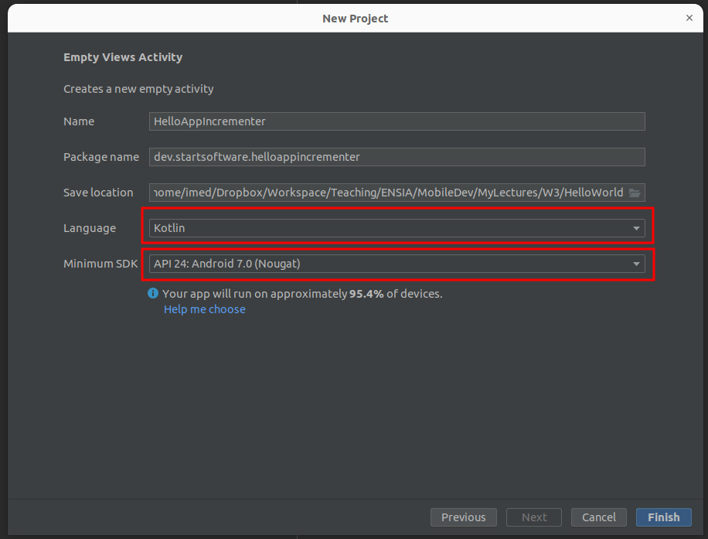
Getting Started : Hello World App
Create a Project
Under Android Studio :
File ⇒ New ⇒ New Project
In the next Wizard select : Empty Views Activity otherwise ,Empty Activity
1
This is why we started with Kotlin from week 1 : Feel free to use Java too.
Which version of Android ?

Slide 26
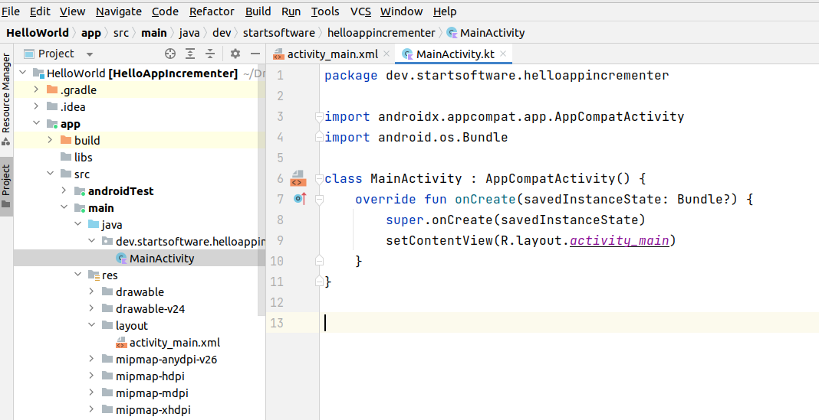
Getting Started : Hello World App
1

Slide 27
Getting Started : Hello World App
Open the Activity View XML File
Navigate to :
App → src → main → res → layout : activity_main.xml
To see the code for the XML file :
Click on : Code ( shown on next slide )
2

Slide 28
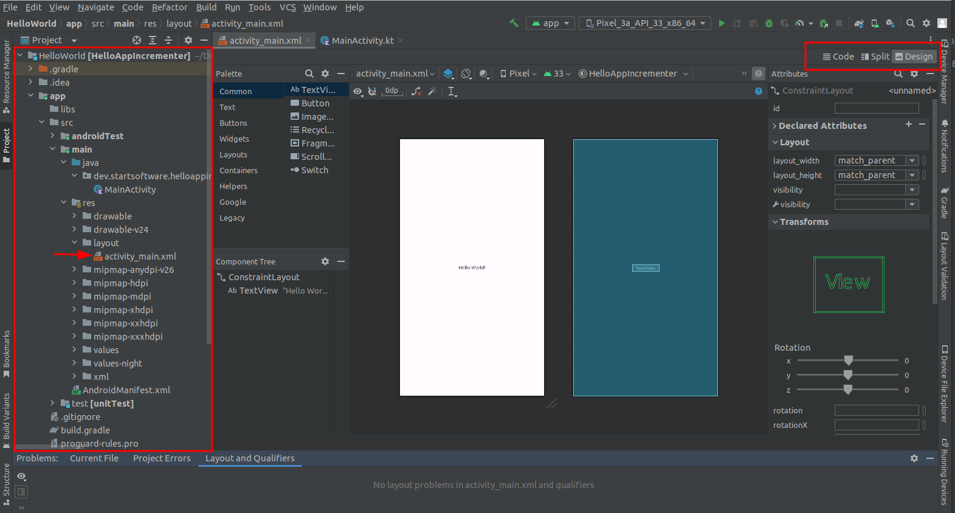
Getting Started : Hello World App
Open the Activity View XML File
2

Slide 29
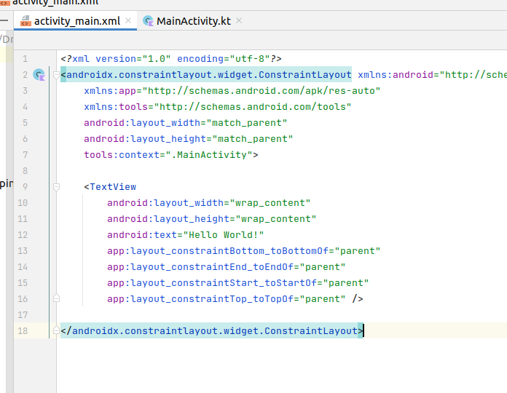
Getting Started : Hello World App
Open the Activity View XML File
2

Slide 30
Getting Started : Hello World App
Adding UI Widgets
We change the text view hello world :
Better practice to have an Id for each component
3

Slide 31
Getting Started : Hello World App
Adding UI Widgets
We add another TextView to show the number of clicks
3
<TextView
android:id="@+id/tx_numberClicks"
android:layout_width="wrap_content"
android:layout_height="wrap_content"
android:text="TextView"
android:gravity="center"
app:layout_constraintStart_toStartOf="@+id/tx_youClicked"
app:layout_constraintEnd_toEndOf="@+id/tx_youClicked"
app:layout_constraintTop_toBottomOf="@+id/tx_youClicked"
android:layout_marginTop="50dp"
/>

Slide 32
Getting Started : Hello World App
Adding UI Widgets
We add a button for Clicking
3
<Button
android:id="@+id/bt_clickme"
android:layout_width="wrap_content"
android:layout_height="wrap_content"
android:text="Button"
android:gravity="center"
android:layout_marginTop="50dp"
app:layout_constraintStart_toStartOf="@+id/tx_numberClicks"
app:layout_constraintEnd_toEndOf="@+id/tx_numberClicks"
app:layout_constraintTop_toBottomOf="@+id/tx_numberClicks"
/>

Slide 33
<?xml version="1.0" encoding="utf-8"?>
<androidx.constraintlayout.widget.ConstraintLayout xmlns:android="http://schemas.android.com/apk/res/android"
xmlns:app="http://schemas.android.com/apk/res-auto"
xmlns:tools="http://schemas.android.com/tools"
android:layout_width="match_parent"
android:layout_height="match_parent"
tools:context=".MainActivity">
<TextView
android:id="@+id/tx_youClicked"
android:layout_width="wrap_content"
android:layout_height="wrap_content"
android:text="You clicked : "
android:textColor="#777"
android:textSize="22sp"
android:gravity="center"
android:layout_marginTop="50dp"
app:layout_constraintBottom_toBottomOf="@+id/tx_numberClicks"
app:layout_constraintEnd_toEndOf="parent"
app:layout_constraintStart_toStartOf="parent"
app:layout_constraintTop_toTopOf="parent" />
<TextView
android:id="@+id/tx_numberClicks"
android:layout_width="wrap_content"
android:layout_height="wrap_content"
android:text="TextView"
android:gravity="center"
app:layout_constraintStart_toStartOf="@+id/tx_youClicked"
app:layout_constraintEnd_toEndOf="@+id/tx_youClicked"
app:layout_constraintTop_toBottomOf="@+id/tx_youClicked"
android:layout_marginTop="50dp"
/>
<Button
android:id="@+id/bt_clickme"
android:layout_width="wrap_content"
android:layout_height="wrap_content"
android:text="Button"
android:gravity="center"
android:layout_marginTop="50dp"
app:layout_constraintStart_toStartOf="@+id/tx_numberClicks"
app:layout_constraintEnd_toEndOf="@+id/tx_numberClicks"
app:layout_constraintTop_toBottomOf="@+id/tx_numberClicks"
/>
</androidx.constraintlayout.widget.ConstraintLayout>
3

Slide 34
Getting Started : Hello World App
Creating the Event for Click Actions
Inside the main activity kotlin code :
4
class MainActivity : AppCompatActivity() {
override fun onCreate(savedInstanceState: Bundle?) {
super.onCreate(savedInstanceState)
setContentView(R.layout.activity_main)
var bt_clickme=findViewById<Button>(R.id.bt_clickme)
bt_clickme.setOnClickListener { println("Clicked...") }
}
}

Slide 35
Getting Started : Hello World App
Creating the Event for Click Actions
Using the Designer or XML :
Important : Run your project from time to time, don’t let it grow complex without testing how it look like
4

Slide 36
Getting Started : Hello World App
Adding Business Logic for Click Event:
5
override fun onCreate(savedInstanceState: Bundle?) {
super.onCreate(savedInstanceState)
setContentView(R.layout.activity_main)
var increment=0
var bt_clickme=findViewById<Button>(R.id.bt_clickme)
var tx_result=findViewById<TextView>(R.id.tx_numberClicks)
bt_clickme.setOnClickListener {
increment=increment+1
tx_result.setText(""+increment)
}
}

Slide 37
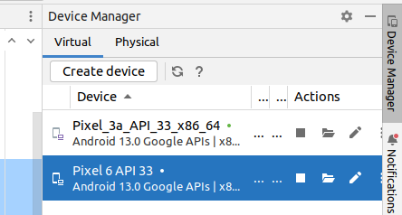

Getting Started : Hello World App
Run the application
You can create a new Emulator if you don’t have one
To run the app :
6

Slide 38
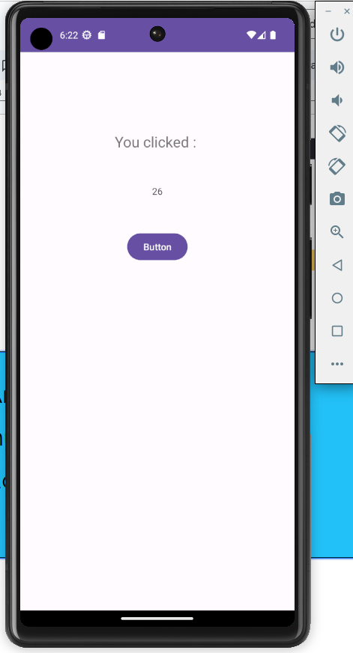
Getting Started : Hello World App
To detach the emulator from Android Studio : File → Settings → Tools → Emulator (Android Studio > and deselect Launch in a tool window.
Run the application
You can create a new Emulator if you don’t have one
Or run it on your phone
6

Slide 39
Getting Started : Hello World App
Run the application
You can run the App on your phone, provided that :
You need to enable USB debugging from the developers options on your phone.
Authorize the pairing on your phone to your pc when asked just after you connect your phone to your PC
Recommended always to run on your physical phone from time to time
6

Slide 40
Getting Started : Hello World App
Polish more the Application : Coloring and Styles
You can directly type the instructions in the XML file or use the attributes palette.
7
<Button
android:id="@+id/bt_clickme"
android:layout_width="wrap_content"
android:layout_height="wrap_content"
android:layout_marginTop="50dp"
android:background="#3F51B5"
android:gravity="center"
android:text="Click me"
app:layout_constraintEnd_toEndOf="@+id/tx_numberClicks"
app:layout_constraintStart_toStartOf="@+id/tx_numberClicks"
app:layout_constraintTop_toBottomOf="@+id/tx_numberClicks" />

Slide 41
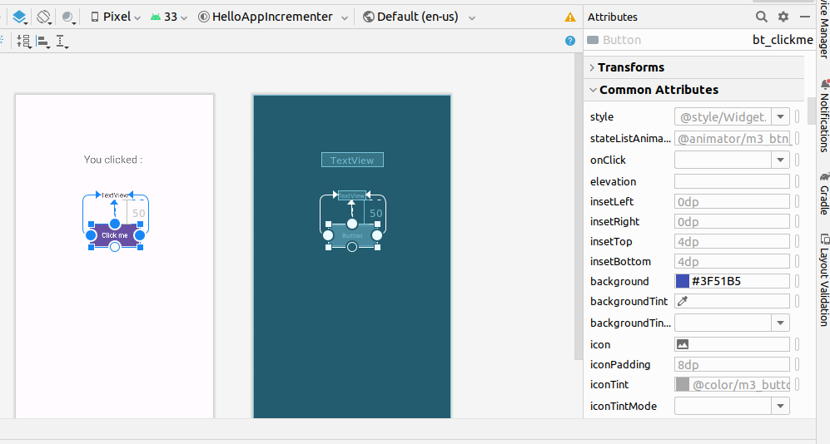
Getting Started : Hello World App
You can make use of the attribute panel to customize the design of your UI components
Polish more the Application : Coloring and Styles
7

Slide 42
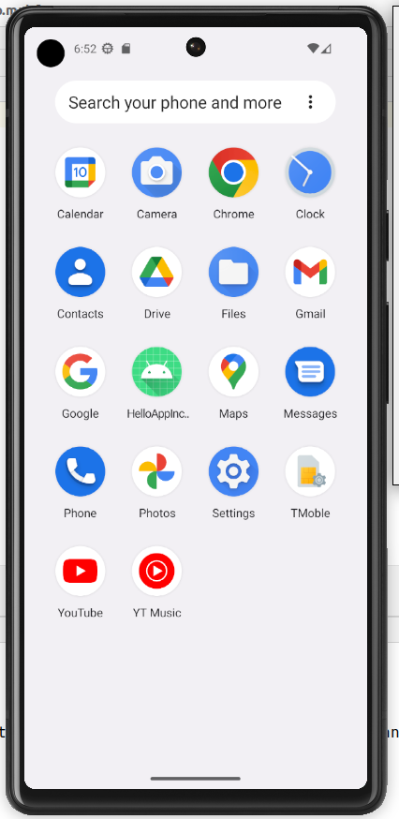
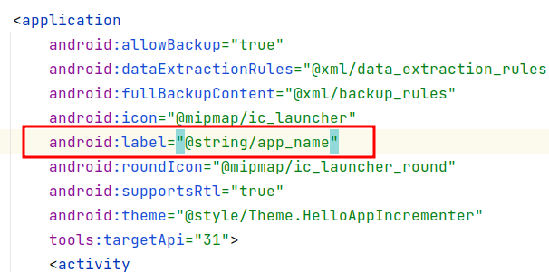
Getting Started : Hello World App
Polish more the Application : Icons and Name
For the name of the App, to change it:
Open manifest.xml
Click on the android:label
8

Slide 43
Getting Started : Hello World App
Polish more the Application : Icons and Name
For the name of the App, to change it:
This is a variable string to be change From the strings resource:
src →main → res →values → strings.xml
8

Slide 44
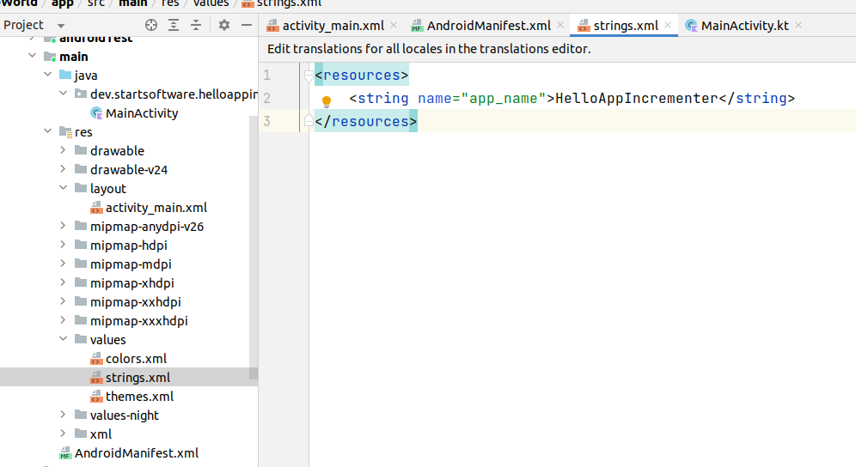
Getting Started : Hello World App
Polish more the Application : Icons and Name
For the name of the App, to change it:
This is a variable string to be change From the strings resource:
src →main → res →values → strings.xml
8

Slide 45
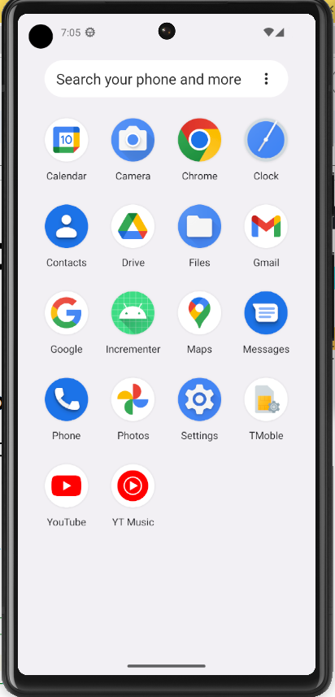
Getting Started : Hello World App
Polish more the Application : Icons and Name
For the icon
Design an Icon, Or you can use your logo
Visit any online web services to generate the icon files from your image Example : https://icon.kitchen/ ….
Download the ZIP file containing the images.
Unzip and place the files inside your PC
8

Slide 46
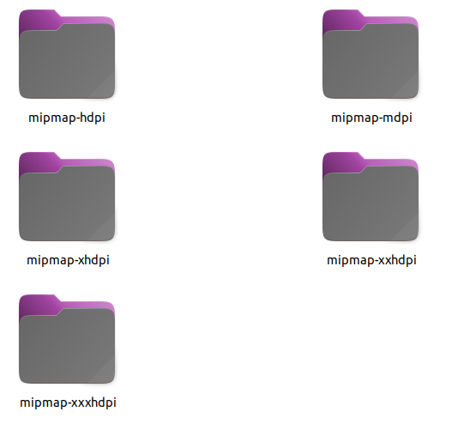
Getting Started : Hello World App
Polish more the Application : Icons and Name
For the icon
files
8

Slide 47
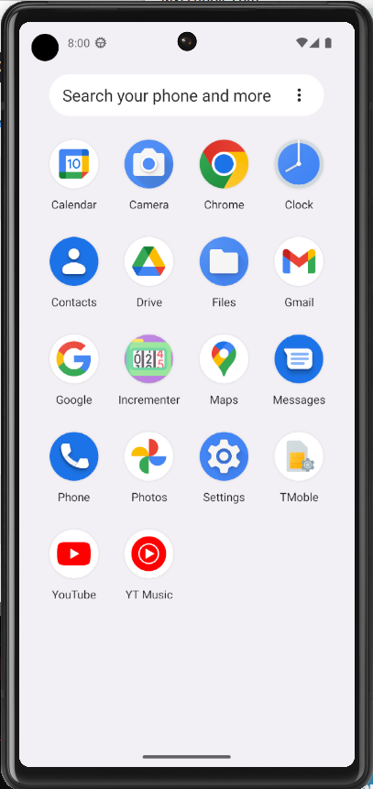
Getting Started : Hello World App
Polish more the Application : Icons and Name
For the icon
Carefully,
Backup the folder : src/main/res
For each folder generated for the icon, Before you copy it to the res Remove the one in res within the project
8

Slide 48
Getting Started : Hello World App
Use and Test the App as much as possible:
Logcat : Although, println can be used to show debug messages, you can also use the android.util.log class:
9
import android.util.Log
class MainActivity : AppCompatActivity() {
private val TAG = "AppIncrementer"
override fun onCreate(savedInstanceState: Bundle?) {
…
Log.v(TAG, "Button Clicked , incremeting result to " + increment);
…
}

Slide 49
Getting Started : Hello World App
Use and Test the App as much as possible:
Logcat :
You can use the following methods:
Log.v(), Log.d(), Log.i(), Log.w(), and Log.e() for ( verbose, debug, information, warning, error respectively)
9

Slide 50
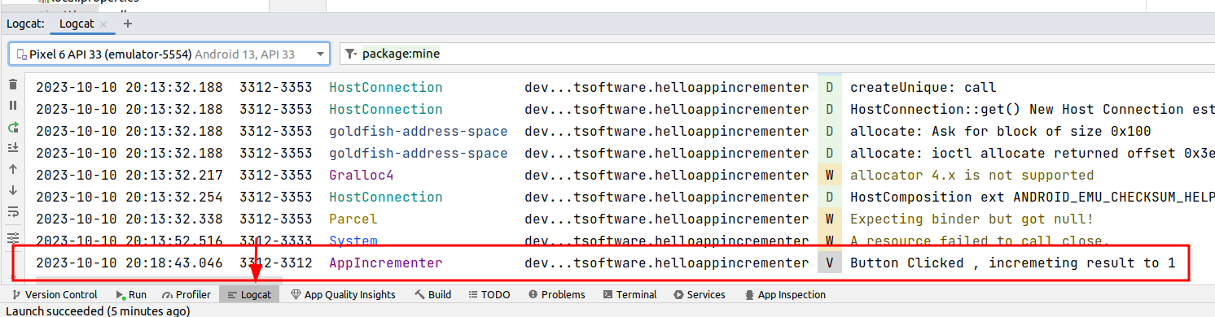
Getting Started : Hello World App
Use and Test the App as much as possible:
Logcat :
9

Slide 51
Getting Started : Hello World App
Use and Test the App as much as possible:
Using Logcat
9

Slide 52
Getting Started : Hello World App
Project Structure :
Android Manifest file :
Description of app read by the Android runtime
Src/Main:
Java : Java/Kotlin source code packages
Res : Resources (XML) - layout, strings, images, dimensions, colors...
build.gradle—Gradle build files

Slide 53
Getting Started : Hello World App
XML Manifest File : AndroidManifest.xml
Located Inside : app/manifests folder
The manifest defines the structure and metadata of your application, its components, and its requirements.
The components of the app, including all activities, services, broadcast receivers, and content providers. Each component must define basic properties, such as the name of its Kotlin or Java class.
The permissions that the app needs in order to access protected parts of the system or other apps.
The hardware and software features the app requires

Slide 54
Getting Started : Hello World App
<?xml version="1.0" encoding="utf-8"?>
<manifest xmlns:android="http://schemas.android.com/apk/res/android"
package="com.tweet_learning">
<uses-permission android:name="android.permission.INTERNET" />
<uses-permission android:name="android.permission.ACCESS_NETWORK_STATE" />
<application
android:allowBackup="true"
android:icon="@mipmap/ic_launcher"
android:label="@string/app_name"
android:roundIcon="@mipmap/ic_launcher_round"
android:supportsRtl="true"
android:usesCleartextTraffic="true"
android:theme="@style/AppTheme.NoActionBar">
<service
android:name="com.tweet_learning.SyncDataIntent"
android:exported="false" />
<activity
android:name="com.tweet_learning.ViewResults"
android:label="@string/title_activity_view_results"
android:theme="@style/AppTheme.NoActionBar" />
<activity android:name="com.tweet_learning.MainActivity">
<intent-filter>
<action android:name="android.intent.action.MAIN" />
<category android:name="android.intent.category.LAUNCHER" />
</intent-filter>
</activity>
</application>
</manifest>
Example for an Android Manifest XML File

Slide 55
Getting Started : Hello World App
Gradle File
Gradle is a build automation tool used primarily for building, compiling, and packaging software projects.
Same as Maven
Does not use XML but uses domain specific language (DSL)

Slide 56
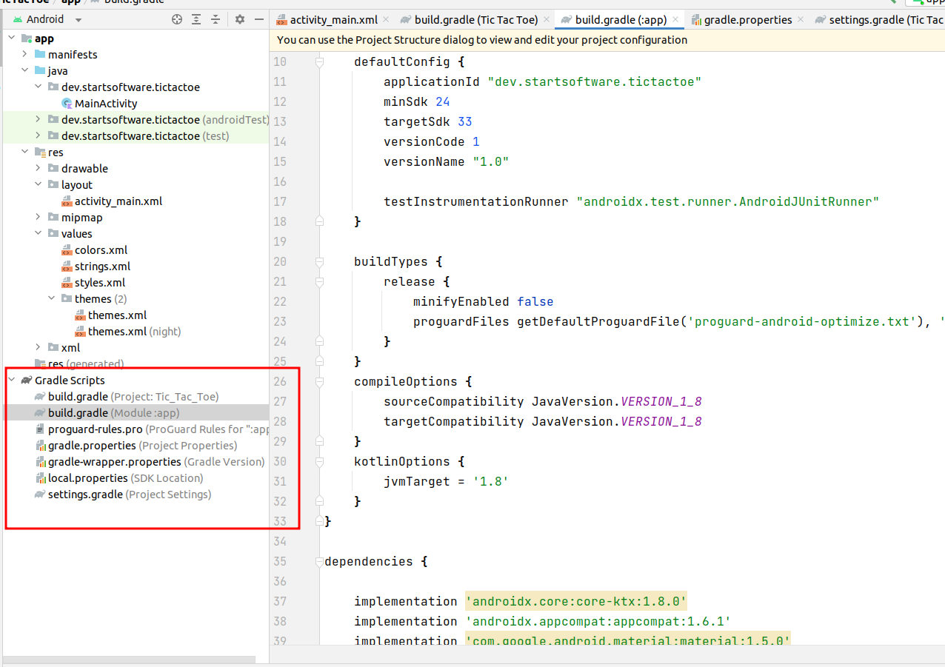
Getting Started : Hello World App

Slide 57
Android App Components : Activities
Activity :
According to Google:
An Activity is an application component that provides a screen with which users can interact in order to do something.
It is a just a single screen within your mobile app.

Slide 58
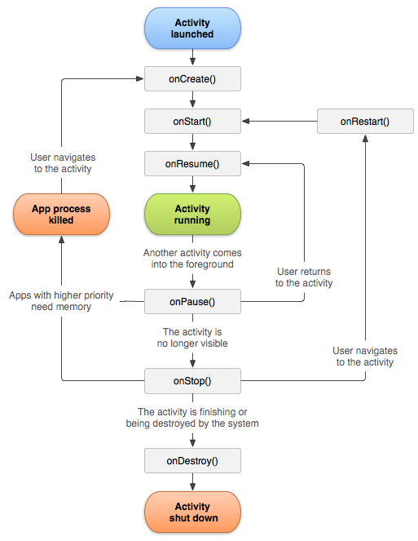
Android App Components : Activities
Activity Life Cycle:
https://info448.github.io/activities.html#making-activities

Slide 59
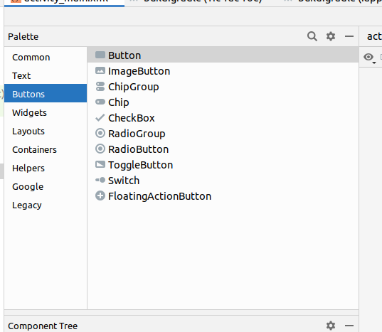
Android App Components : UI Widgets
Android UI Components can be tested via experimenting the design utility.

Slide 60
Android App Components : Layouts
The activity screen includes many Views contained within one or more nested layouts.
By combining different layouts and Views, you can create arbitrarily complex UIs.
Android SDK includes many layout including : LinearLayout, TableLayout, RelativeLayout, ConstrainedLayout…

Slide 61
Android App Components : Layouts
ConstraintLayout : Using constraints, edges, and guidelines to control how the elements are positioned relative to other elements in the layout. ConstraintLayout was designed to make it easy to click and drag View elements in the layout editor.
LinearLayout : Elements positioned and aligned horizontally or vertically.
RelativeLayout : Each element is positioned and aligned relative to other elements within the ViewGroup. In other words, the positions of the child View elements can be described in relation to each other or to the parent ViewGroup.
TableLayout : Elements arranged into rows and columns.
GridLayout, FrameLayout..

Slide 62
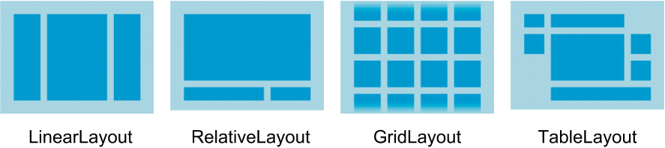
Android App Components : Layouts

Slide 63

Section 2
Example : Tic Tac Toe

Slide 64
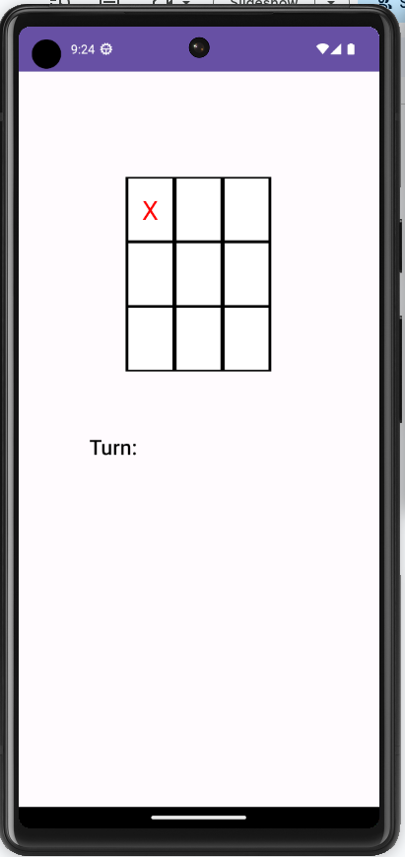
Mobile App Example : Tic Tac Toe Game
Wireframe of the App :
Only one screen is needed
Therefore, one activity

Slide 65
Mobile App Example : Tic Tac Toe Game
SIMPLE Steps to get started :
Create the View on the XML File
LinearLayout is used
TableLayout is used for the grid
TextViews are used to fill each cell
TextView is shown at the bottom to show the turn

Slide 66
<?xml version="1.0" encoding="utf-8"?>
<LinearLayout xmlns:android="http://schemas.android.com/apk/res/android"
xmlns:app="http://schemas.android.com/apk/res-auto"
xmlns:tools="http://schemas.android.com/tools"
android:layout_width="match_parent"
android:layout_height="match_parent"
android:paddingTop="10dp"
android:paddingRight="10dp"
android:paddingLeft="10dp"
android:orientation="vertical"
tools:context=".MainActivity">
<TableLayout
android:id="@+id/mainBoard"
android:layout_width="wrap_content"
android:layout_height="wrap_content"
android:layout_gravity="top|center"
android:clickable="true"
android:gravity="center"
android:layout_marginTop="100dp"
android:nestedScrollingEnabled="false"
android:padding="10dp">
<TableRow
android:id="@+id/row0"
style="@style/TableRow"
android:layout_width="match_parent"
android:layout_height="match_parent">
<TextView
android:id="@+id/tx_a1"
style="@style/LeftCell"
android:width="50dp"
android:layout_column="0"></TextView>
<TextView
android:id="@+id/tx_a2"
style="@style/MiddleCell"
android:width="50dp"
android:layout_column="1"></TextView>
<TextView
android:id="@+id/tx_a3"
style="@style/RightCell"
android:width="50dp"
android:layout_column="2"></TextView>
</TableRow>
…
</TableRow>
</TableLayout>
<TextView android:layout_height="wrap_content"
android:layout_width="fill_parent"
android:id="@+id/tx_turn"
android:padding="10dp"
android:layout_marginTop="50dp"
android:gravity="left"
android:textColor="@color/black"
android:fontFamily="sans-serif-medium"
android:textSize="24dp"
android:text="Turn of Player : 1 "/>
</LinearLayout>

Slide 67
<?xml version="1.0" encoding="utf-8"?>
<LinearLayout xmlns:android="http://schemas.android.com/apk/res/android"
xmlns:app="http://schemas.android.com/apk/res-auto"
xmlns:tools="http://schemas.android.com/tools"
android:layout_width="match_parent"
android:layout_height="match_parent"
android:paddingTop="10dp"
android:paddingRight="10dp"
android:paddingLeft="10dp"
android:orientation="vertical"
tools:context=".MainActivity">
<TableLayout
android:id="@+id/mainBoard"
android:layout_width="wrap_content"
android:layout_height="wrap_content"
android:layout_gravity="top|center"
android:clickable="true"
android:gravity="center"
android:layout_marginTop="100dp"
android:nestedScrollingEnabled="false"
android:padding="10dp">
<TableRow
android:id="@+id/row0"
style="@style/TableRow"
android:layout_width="match_parent"
android:layout_height="match_parent">
<TextView
android:id="@+id/tx_a1"
style="@style/LeftCell"
android:width="50dp"
android:layout_column="0"></TextView>
<TextView
android:id="@+id/tx_a2"
style="@style/MiddleCell"
android:width="50dp"
android:layout_column="1"></TextView>
<TextView
android:id="@+id/tx_a3"
style="@style/RightCell"
android:width="50dp"
android:layout_column="2"></TextView>
</TableRow>
…
</TableRow>
</TableLayout>
<TextView android:layout_height="wrap_content"
android:layout_width="fill_parent"
android:id="@+id/tx_turn"
android:padding="10dp"
android:layout_marginTop="50dp"
android:gravity="left"
android:textColor="@color/black"
android:fontFamily="sans-serif-medium"
android:textSize="24dp"
android:text="Turn of Player : 1 "/>
</LinearLayout>
Another better choice to use is : 3 Horizontal LinearLayouts inside Vertical LinearLayout

Slide 68
Mobile App Example : Tic Tac Toe Game
SIMPLE Steps to get started :
Write the Kotlin Code:
Possible Easy Algorithm:
For a given cell, register a Click Listener
With the Event Handler :
If the Cell contains Text, do nothing
If the turn is 1, make it X otherwise, set it to O
Change the turn variable.
Check if there is a win

Slide 69
class MainActivity : AppCompatActivity() {
var turn =1
override fun onCreate(savedInstanceState: Bundle?) {
super.onCreate(savedInstanceState)
setContentView(R.layout.activity_main)
var item=findViewById<TextView>(R.id.tx_a1)
item.setOnClickListener { processClickEvent(1) }
}
fun processClickEvent(cell: Int){
if (cell==1){
var existingValue:String=findViewById<TextView>(R.id.tx_a1).text.toString()
if (existingValue.length>0){
return
}
if (turn==1) {
findViewById<TextView>(R.id.tx_a1).setText("X")
findViewById<TextView>(R.id.tx_a1).setTextColor(Color.parseColor("#ff0000"))
turn=2
}else{
findViewById<TextView>(R.id.tx_a1).setText("O")
findViewById<TextView>(R.id.tx_a1).setTextColor(Color.parseColor("#00ff00"))
turn=1
} //Check if there is a win ?
}
}
}

Slide 70
class MainActivity : AppCompatActivity() {
var turn =1
override fun onCreate(savedInstanceState: Bundle?) {
super.onCreate(savedInstanceState)
setContentView(R.layout.activity_main)
var item=findViewById<TextView>(R.id.tx_a1)
item.setOnClickListener { processClickEvent(1) }
}
fun processClickEvent(cell: Int){
if (cell==1){
var existingValue:String=findViewById<TextView>(R.id.tx_a1).text.toString()
if (existingValue.length>0){
return
}
if (turn==1) {
findViewById<TextView>(R.id.tx_a1).setText("X")
findViewById<TextView>(R.id.tx_a1).setTextColor(Color.parseColor("#ff0000"))
turn=2
}else{
findViewById<TextView>(R.id.tx_a1).setText("O")
findViewById<TextView>(R.id.tx_a1).setTextColor(Color.parseColor("#00ff00"))
turn=1
} //Check if there is a win ?
}
}
}
You have to Repeat Yourself for the other 8 cells ?

Slide 71
class MainActivity : AppCompatActivity() {
var turn =1
override fun onCreate(savedInstanceState: Bundle?) {
super.onCreate(savedInstanceState)
setContentView(R.layout.activity_main)
var cells= arrayOf(R.id.tx_a1,R.id.tx_a2,R.id.tx_a3,R.id.tx_a4,R.id.tx_a5,R.id.tx_a6,R.id.tx_a7,R.id.tx_a8,R.id.tx_a9)
for (cell in cells) {
var item=findViewById<TextView>(cell)
item.setOnClickListener { processClickEvent(cell) }
}
}
fun processClickEvent(cellId: Int){
var existingValue:String=findViewById<TextView>(cellId).text.toString()
if (existingValue.length>0){
return
}
if (turn==1) {
findViewById<TextView>(cellId).setText("X")
findViewById<TextView>(cellId).setTextColor(Color.parseColor("#ff0000"))
turn=2
}else {
findViewById<TextView>(cellId).setText("O")
findViewById<TextView>(cellId).setTextColor(Color.parseColor("#00ff00"))
turn = 1
}
findViewById<TextView>(R.id.tx_turn).setText("Turn of Player: "+turn)
}
}

Slide 72
class MainActivity : AppCompatActivity() {
var turn =1
override fun onCreate(savedInstanceState: Bundle?) {
super.onCreate(savedInstanceState)
setContentView(R.layout.activity_main)
var cells= arrayOf(R.id.tx_a1,R.id.tx_a2,R.id.tx_a3,R.id.tx_a4,R.id.tx_a5,R.id.tx_a6,R.id.tx_a7,R.id.tx_a8,R.id.tx_a9)
for (cell in cells) {
var item=findViewById<TextView>(cell)
item.setOnClickListener { processClickEvent(cell) }
}
}
fun processClickEvent(cellId: Int){
var existingValue:String=findViewById<TextView>(cellId).text.toString()
if (existingValue.length>0){
return
}
if (turn==1) {
findViewById<TextView>(cellId).setText("X")
findViewById<TextView>(cellId).setTextColor(Color.parseColor("#ff0000"))
turn=2
}else {
findViewById<TextView>(cellId).setText("O")
findViewById<TextView>(cellId).setTextColor(Color.parseColor("#00ff00"))
turn = 1
}
findViewById<TextView>(R.id.tx_turn).setText("Turn of Player: "+turn)
}
}
How to know there is a winner ?

Slide 73
Mobile App Example : Tic Tac Toe Game
SIMPLE Steps to get started :
Write the Kotlin Code:
Checking if there is a winner ? Brute Force :
Write down all possible solutions
After each move,
Loop through possible solutions,
Check if the sequence of letters are the same

Slide 74
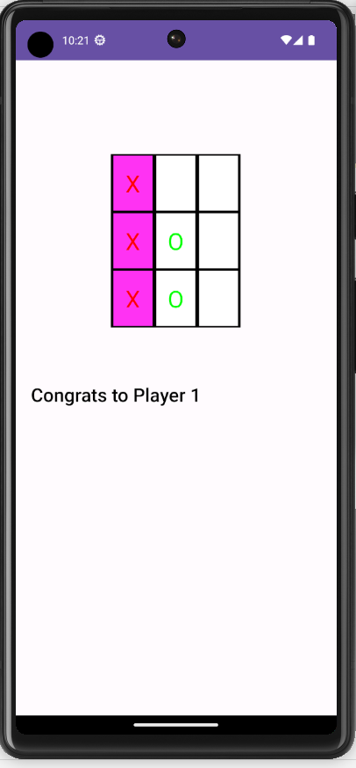
var win=checkWin()
if (win){
findViewById<TextView>(R.id.tx_turn).setText("Congrats to Player "+turn)
gameover=true
return
}
turn=if (turn==1) 2 else 1
findViewById<TextView>(R.id.tx_turn).setText("Turn of Player: "+turn)
}
var possible_wins= arrayOf(
arrayOf(R.id.tx_a1,R.id.tx_a2,R.id.tx_a3),
arrayOf(R.id.tx_a4,R.id.tx_a5,R.id.tx_a6),
arrayOf(R.id.tx_a7,R.id.tx_a8,R.id.tx_a9),
arrayOf(R.id.tx_a1,R.id.tx_a5,R.id.tx_a9),
arrayOf(R.id.tx_a7,R.id.tx_a5,R.id.tx_a3),
arrayOf(R.id.tx_a1,R.id.tx_a4,R.id.tx_a7),
arrayOf(R.id.tx_a2,R.id.tx_a5,R.id.tx_a8),
arrayOf(R.id.tx_a3,R.id.tx_a6,R.id.tx_a9))
fun checkWin(): Boolean{
for (possible in possible_wins){
var seqStr=""
for (cellId in possible){
var existingValue:String=findViewById<TextView>(cellId).text.toString()
if (existingValue.length==0)break
seqStr=seqStr+existingValue
}
if (seqStr=="OOO" || seqStr=="XXX") {
for (cellId in possible){
findViewById<TextView>(cellId).setBackgroundColor(Color.parseColor("#eeeeee"))
}
return true
}
}
return false
}

Slide 75
var win=checkWin()
if (win){
findViewById<TextView>(R.id.tx_turn).setText("Congrats to Player "+turn)
gameover=true
return
}
turn=if (turn==1) 2 else 1
findViewById<TextView>(R.id.tx_turn).setText("Turn of Player: "+turn)
}
var possible_wins= arrayOf(
arrayOf(R.id.tx_a1,R.id.tx_a2,R.id.tx_a3),
arrayOf(R.id.tx_a4,R.id.tx_a5,R.id.tx_a6),
arrayOf(R.id.tx_a7,R.id.tx_a8,R.id.tx_a9),
arrayOf(R.id.tx_a1,R.id.tx_a5,R.id.tx_a9),
arrayOf(R.id.tx_a7,R.id.tx_a5,R.id.tx_a3),
arrayOf(R.id.tx_a1,R.id.tx_a4,R.id.tx_a7),
arrayOf(R.id.tx_a2,R.id.tx_a5,R.id.tx_a8),
arrayOf(R.id.tx_a3,R.id.tx_a6,R.id.tx_a9))
fun checkWin(): Boolean{
for (possible in possible_wins){
var seqStr=""
for (cellId in possible){
var existingValue:String=findViewById<TextView>(cellId).text.toString()
if (existingValue.length==0)break
seqStr=seqStr+existingValue
}
if (seqStr=="OOO" || seqStr=="XXX") {
for (cellId in possible){
findViewById<TextView>(cellId).setBackgroundColor(Color.parseColor("#eeeeee"))
}
return true
}
}
return false
}
However, This code is a mess ! not extensible, not maintainable, not readable, not cohesive…

Slide 76
Section 3
Kotlin : Object Oriented Programming

Slide 77
Kotlin : Object-Oriented Programming
Object-oriented programming has several advantages over procedural programming:
OOP is faster and easier to execute
OOP provides a clear structure for the programs
OOP helps to keep the Kotlin code DRY "Don't Repeat Yourself", and makes the code easier to maintain, modify and debug
OOP makes it possible to create full reusable applications with less code and shorter development time
Copied from https://www.w3schools.com/KOTLIN/kotlin_oop.php

Slide 78
Kotlin : Object-Oriented Programming
Create a class :
class Car {
var brand = ""
var model = ""
var year = 0
}

Slide 79
Kotlin : Object-Oriented Programming
Create an object :
// Create a c1 object of the Car class
val c1 = Car()
// Access the properties and add some values to it
c1.brand = "Ford"
c1.model = "Mustang"
c1.year = 1969
println(c1.brand) // Outputs Ford
println(c1.model) // Outputs Mustang
println(c1.year) // Outputs 1969

Slide 80
Kotlin : Object-Oriented Programming
Default & Concise Constructor
class Car(var brand: String, var model: String, var year: Int)
fun main() {
val c1 = Car("Ford", "Mustang", 1969) //Those values would be assigned automatically to instance variables created implicitly
val c2 = Car("BMW", "X5", 1999)
val c3 = Car("Tesla", "Model S", 2020) println(c1.brand + " " + c1.model + " " + c1.year)
}
Those values will be assigned automatically to instance variables created implicitly

Slide 81
Kotlin : Object-Oriented Programming
Default & other methods
class Car(var brand: String, var model: String, var year: Int) {
// Class function
fun drive() {
println("Wrooom!")
}
// Class function with parameters
fun speed(maxSpeed: Int) {
println("Max speed is: " + maxSpeed)
}
}
fun main() {
val c1 = Car("Ford", "Mustang", 1969)
// Call the functions
c1.drive()
c1.speed(200)
}

Slide 82
Kotlin : Object-Oriented Programming
Inheritance
For parent : open
For child, use :
//base class
open class baseClass{
val name = "GeeksforGeeks"
fun A(){
println("Base Class")
}
}
//derived class
class derivedClass: baseClass() {
fun B() {
println(name) //inherit name property
println("Derived class")
}
}
fun main(args: Array<String>) {
val derived = derivedClass()
derived.A() // inheriting the base class function
derived.B() // calling derived class function
}
Output: Base Class
GeeksforGeeks
Derived class

Slide 83
Kotlin : Object-Oriented Programming
Overriding Functions
// base class
open class Animal {
open fun run() {
println("Animals can run")
}
}
// derived class
class Tiger: Animal() {
override fun run() { // overrides the run method of base class
println("Tiger can run very fast")
}
}
fun main(args: Array<String>) {
val t = Tiger()
t.run()
}
Output: Tiger can run very fast

Slide 84
Kotlin : Object-Oriented Programming
Overriding Functions
What’s next :
Use OOP to improve the Tic Tac Toe Game
// base class
open class Animal {
open fun run() {
println("Animals can run")
}
}
// derived class
class Tiger: Animal() {
override fun run() { // overrides the run method of base class
println("Tiger can run very fast")
}
}
fun main(args: Array<String>) {
val t = Tiger()
t.run()
}
Output: Tiger can run very fast

Slide 85
Project Source Codes
Hello World App : Incrementer :
https://www.dropbox.com/scl/fo/hwqzowqtdbxuxrazf33ac/h?rlkey=ggef744l0n558qyqye1idwenu&dl=0
Tic Tac Toe Game
https://www.dropbox.com/scl/fo/dxr2luubdvtgkrtitzm76/h?rlkey=tun570wgzwrmkzs3u15vvgxh2&dl=0

Slide 86
Resources
https://developer.android.com/courses/android-basics-kotlin/course
https://google-developer-training.github.io/android-developer-fundamentals-course-concepts-v2/
https://drive.google.com/drive/folders/1eu-LXxiHocSktGYpG04PfE9Xmr_pBY5P
https://www.udacity.com/course/developing-android-apps-with-kotlin--ud9012
https://developer.android.com/reference/kotlin/android/util/Log
Kotlin OOP: https://www.geeksforgeeks.org/kotlin-inheritance/
https://www.javatpoint.com/android-ui-widgets-tutorial

